Slide 1
The Art of Statistics – Chapters 11 & 12

Slide 2
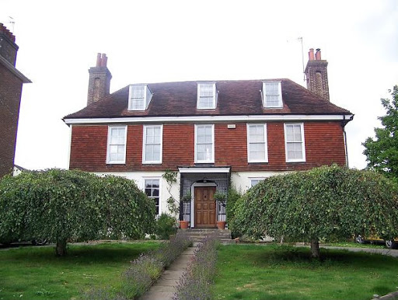
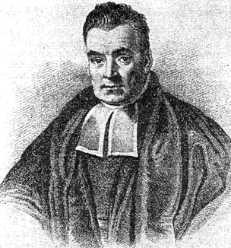
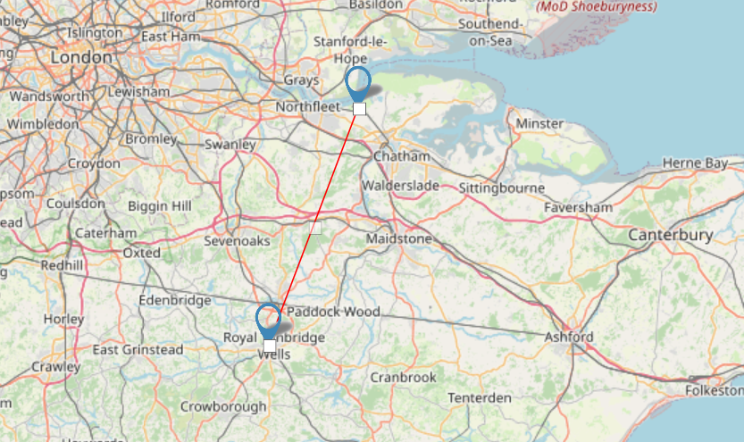
Reverend Thomas Bayes

Slide 3
Forget almost everything we’ve learnt so far

Slide 4
Aleatory certainty vs epistemic uncertainty
Aleatory (un)certainty – uncertainty due to random variation
- Flipping a coin
- Drawing cards from a deck
Epistemic (un)certainty – uncertainty due to lack of knowledge
- The population of the city of Paris
- The number of beers drunk during lockdown
My uncertainty can be reduced in light of new evidence

Slide 5
Bayes Theorem
A rule of probability that shows how evidence A updates prior beliefs of a proposition B to produce posterior beliefs p(B|A)

Slide 6
An example…
3 coins – one with two heads, one with two tails, one with one head and one tail
Pick a random coin and flip it – it comes up heads. What is the probability the other side is a head?

Slide 7

Coin Chosen
Result of first flip
2
Heads
2
0
Tails
Two heads
1
6
2
Heads
Fair
Tails
1
Two tails
2
0
Heads
Tails
2

Slide 8
A bit more complicated…
A screening test for doping in sports is claimed to be 95% accurate – 95% of dopers will be correctly classified, as will 95% of non-dopers.
If we assume 1 in 50 athletes are doping at any given time, what is the probability that an athlete testing positive is actually doping?

Slide 9
95% accurate, 1 in 50 doping, probability of a positive test being a doper
Doping?
Test Result
Chance of doping given a positive test = 28%
OR
72% false accusations!
19
Positive
Doping?
20
1000
Negative
1
Not doping
980
Positive
49
Negative
931

Slide 10
Reversed expected frequency tree
Test Result
Doping?
Same numbers, but respects the temporal order in which we know them
19
Doping
Positive
68
1000
Not doping
49
Negative
932
Doping
1
Not doping
931

Slide 11
Likelihood ratio
A measure of the relative support that some data provides for two competing hypotheses
19
Doping
Positive
68
1000
Not doping
49
1 in 50 (20/1000) doping, 95% accurate (19 of 20 dopers positive), 5% incorrectly tested positive (49)

Slide 12
Likelihood ratio
Positive test result:
Hypothesis A – guilty of doping
Hypothesis B – not guilty of doping
Probability of the evidence, given hypothesis A – 95% (0.95)
Probability of the evidence, given hypothesis B – 5% (0.05)
Likelihood ratio = 0.95/0.05 = 19 – a positive test result is 19 times more likely to happen to a guilty athlete than an innocent one

Slide 13
Back to Bayes Theorem
The initial odds of a hypothesis x the likelihood ratio = the final odds for a hypothesis
Initial odds of athlete is doping – 1/49
Likelihood ratio – 19
Final odds = 1/49 * 19 = 19/49
Transformed to probability – 28%
Initial odds known as prior odds, and final odds known as posterior – and this can be repeated with the posterior odds becoming the new prior odds as more evidence is added

Slide 14
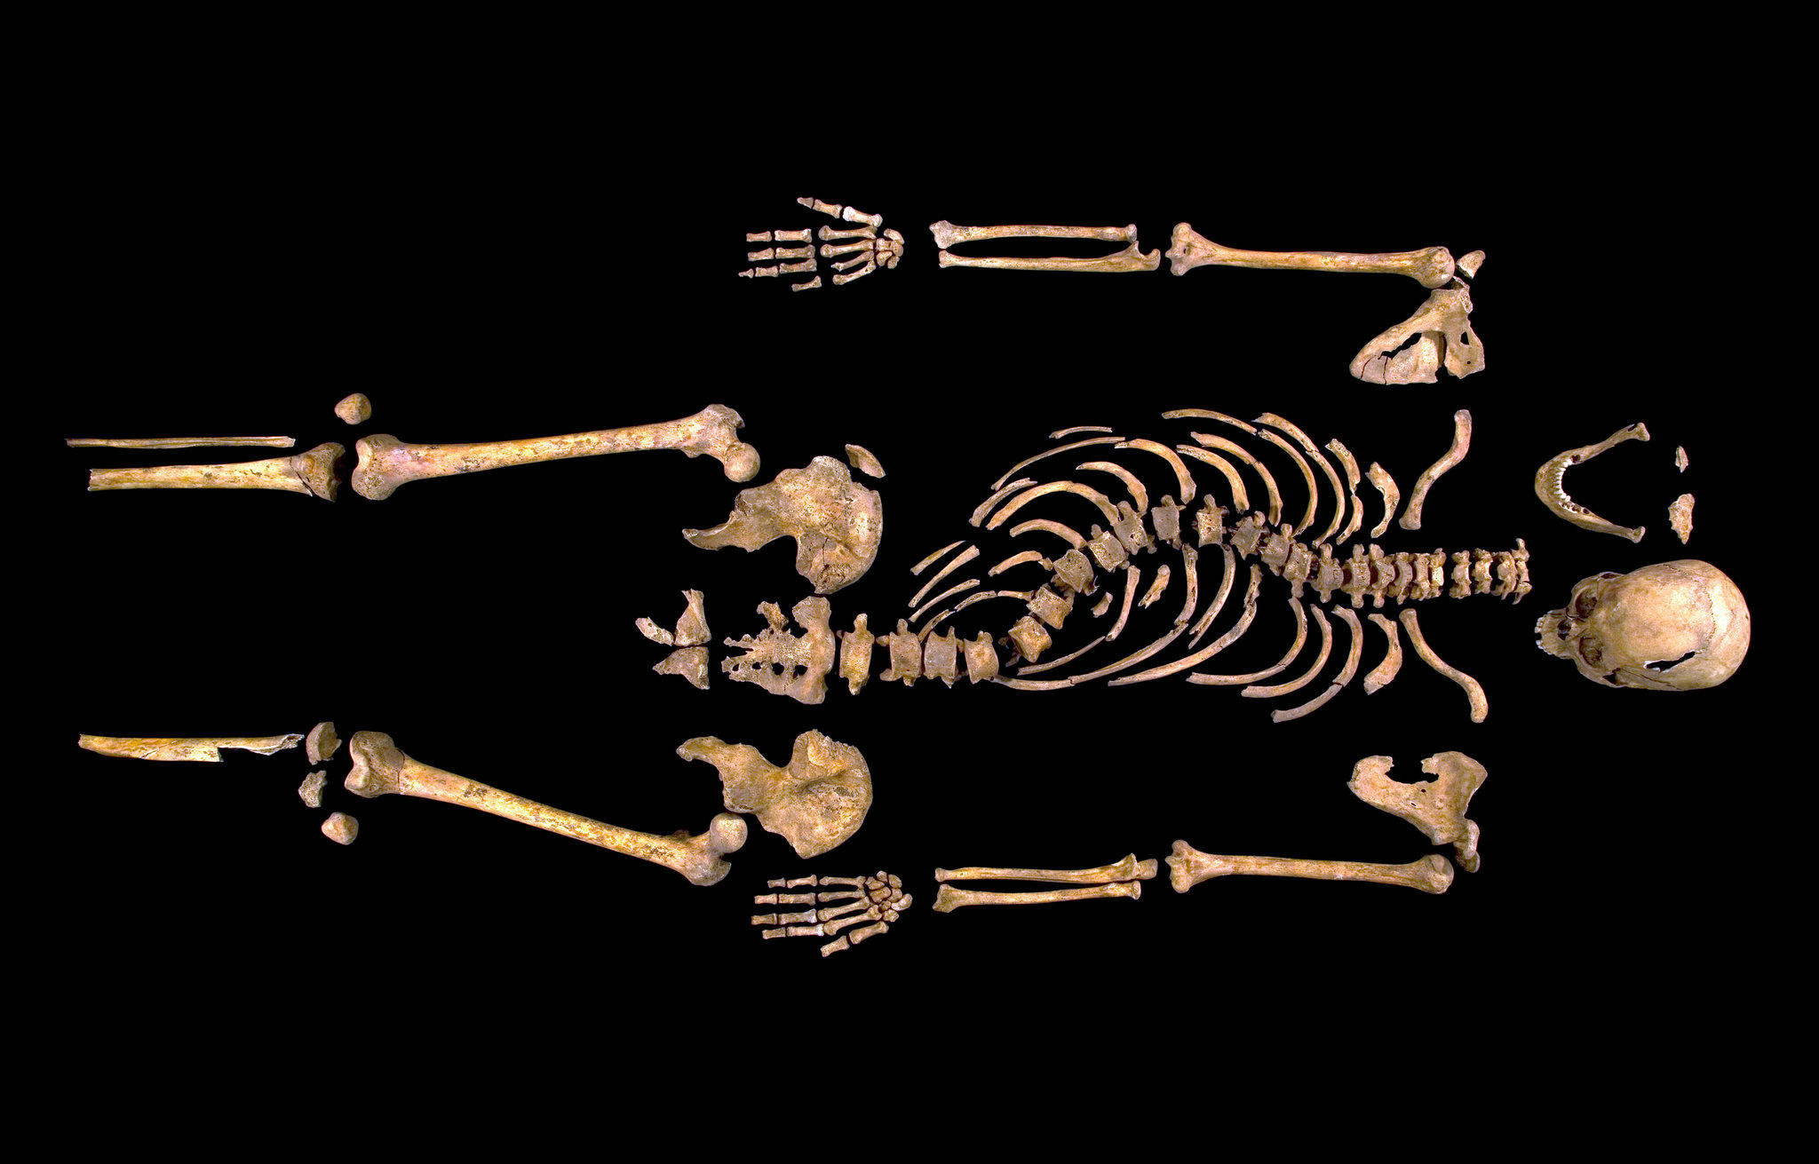
Richard III
Evidence | Likelihood Ratio | Verbal Equivalent
Radiocarbon dating | 1.8 | Weak support
Age and sex | 5.3 | Weak support
Scoliosis | 212 | Moderately strong
Post-mortem wounds | 42 | Moderate support
mtDNA match | 478 | Moderately strong
Y chromosome not matching | 0.16 | Weak against
Combined: | 6.7 million | More than extremely strong support
Led researchers to conclude a 0.999994 probability it was Richard III

Slide 15
Bayesian Statistical Inference
Probability of the next ball being on the left of the line – 2/5?
Number of red balls to the left + 1
Total number of red balls + 2
2 + 1 = 3
5 + 2 = 7

Slide 16
Bayesian statistical inference
Use knowledge about how the position of the line was decided to establish a prior distribution for its position
Combine it with evidence from the data
Gives us the posterior distribution, which expresses all we currently believe about the unknown quantity.

Slide 17
But…
How can you determine the prior distribution?
Subjective judgement
Historical data
Objective priors
No ‘true’ prior distribution!

Slide 18
Multi-level Regression and Post-stratification
MRP
Break population down into ‘cells’ of similar age, gender, past voting etc.
Estimate the number of people in these cells
Assume probability of their voting behaviour

Slide 19
MRP
Build regression model for probability of voting a particular way
Coefficients corresponding to different areas are assumed to be similar – somewhere between completely different and identical
All cells are combined to produce a prediction for the whole

Slide 20
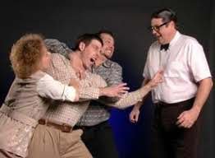
Statisticians argue…

Slide 21
Summary
Bayesian methods are about combining evidence from data with initial beliefs to produce a probability for the unknown quantity
Bayes theorem for competing hypotheses – posterior odds = likelihood ratio x prior odds
Likelihood ratio expresses the relative support for two hypotheses from an item of evidence
A degree of judgement is generally necessary for prior distribution
Hierarchical modelling allows evidence to be pooled across multiple small analyses

Slide 22
How things go wrong
The Daily Mails Cause/Prevent Cancer list: https://kill-or-cure.herokuapp.com/
Ben Goldacre: https://www.ted.com/talks/ben_goldacre_what_doctors_don_t_know_about_the_drugs_they_prescribe?language=en

Slide 23
Discussion pointers
Given the problems discussed in chapter 12, how could things be done better?
What role does the individual statistician/data analyst have in ensuring transparency?
Any horror stories?

